Slide 1
Developing Your Bodhrán Toolkit
PASIC50 - November 13, 2025
Jeremy Wade (Bodhrán) | Justin Bridgebeck (Fiddle)

Slide 2
Goals
Learn the basic elements of bodhrán technique
Identify and adapt musical concepts that are already in your “toolkit”
Apply your “toolkit” to accompany an Irish reel

Slide 3
“Toolkit” Defined
Technical Vocabulary
  Technique
  Muscle Memory
Musical Vocabulary
  Stylistic Knowledge
  Context Generalization

Slide 4
Technique Crash Course

Slide 5
Adapting Common Exercises/ Grooves
Snare Drum
Eights
Hugga Digga Burr
Natural Sticking
4-2-1 Grid
Double Beat
Mallets
Green

Slide 6
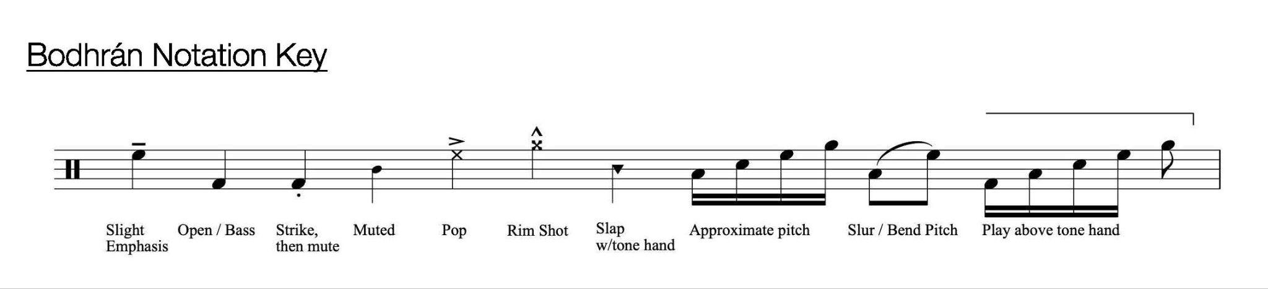
Bodhrán Notation
Sourced from EscALE8 (Chad Floyd)
Sticking
D = Down
U = Up
T = Tap
B = Back

Slide 7
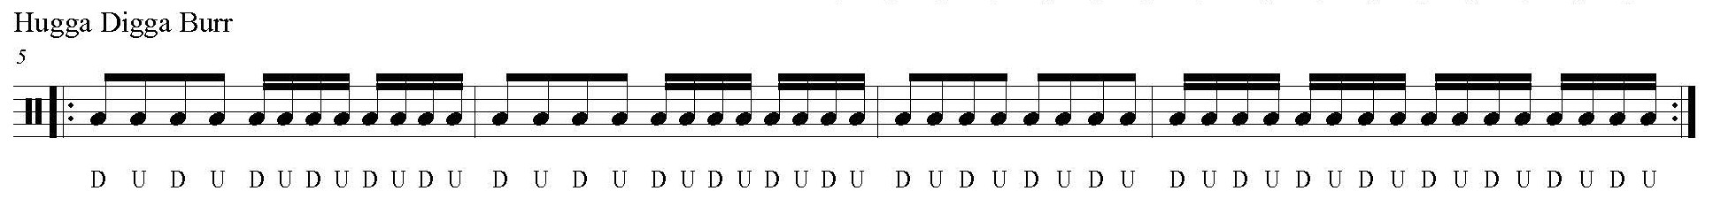
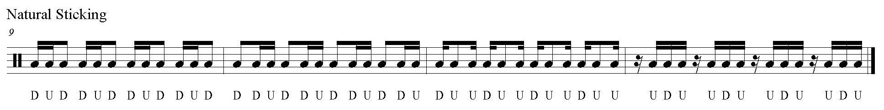
Adapting Common Exercises/ Grooves

Slide 8
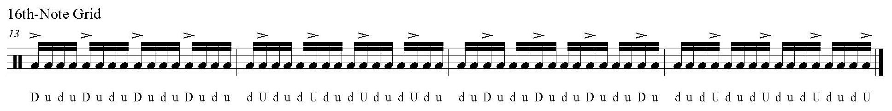
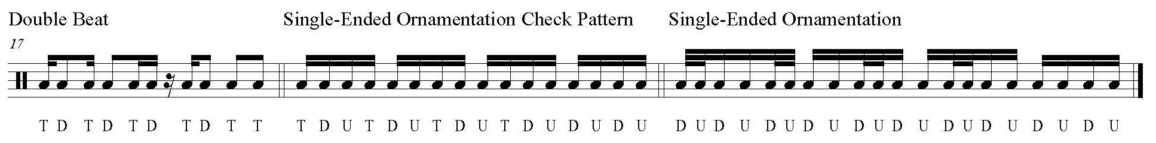
Adapting Common Exercises/ Grooves

Slide 9
Adapting Common Exercises/ Grooves
Snare Drum
Eights
Hugga Digga Burr
Natural Sticking
4-2-1 Grid
Double Beat
Mallets
Green
Drum Set
Basic Rock
16th-Note Rock
6/8 Blues
Swing
Train Beat

Slide 10
Irish Traditional Music
Tune Characteristics
Instrumental
Composed for dance
  8-bar step is performed beginning with the right leg, then mirrored on the left
Emphasis on rhythm and melody
Repetition facilitates rote learning
Organized into “sets” of like-tunes (i.e. same meter)
Typical Form - AABB
8-Bar “A” Section
Repeat
  May include 1st/ 2nd endings
8-Bar “B” Section
Repeat
  May include 1st/ 2nd endings
  2nd ending often mirrors the “A” section
Da Capo
Repeat Tune 2-3 Times

Slide 11
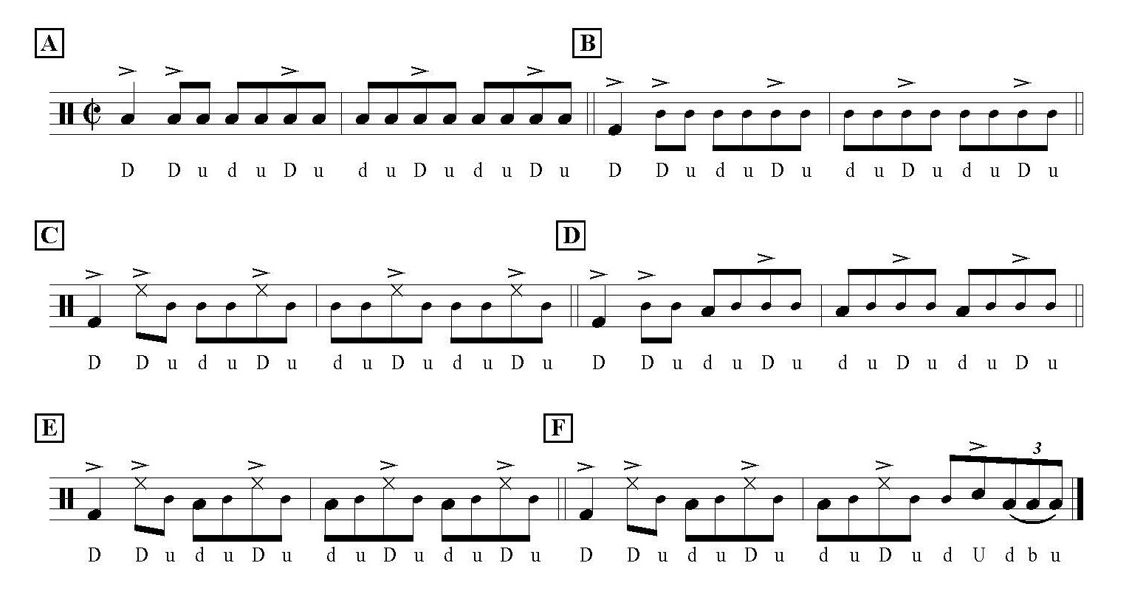
Reel Motor Rhythms

Slide 12
Interpreting Tunes on Bodhrán
Space
  Identifying and emphasizing moments of rhythmic variety (i.e. rests/ longer note values).
Voicing
  Applying tonal variation to add texture, contour, and harmonization.
Sticking
  Combining “down,” “up,” and “tap” strokes to influence phrasing and shift between playing zones.
Ornamentation
  Using double and single-ended figures to embellish rhythmic motives and add energy to fills.

Slide 13
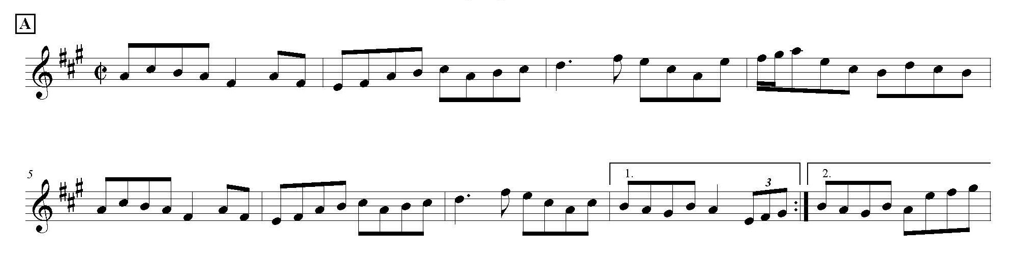
Frank’s Reel

Slide 14
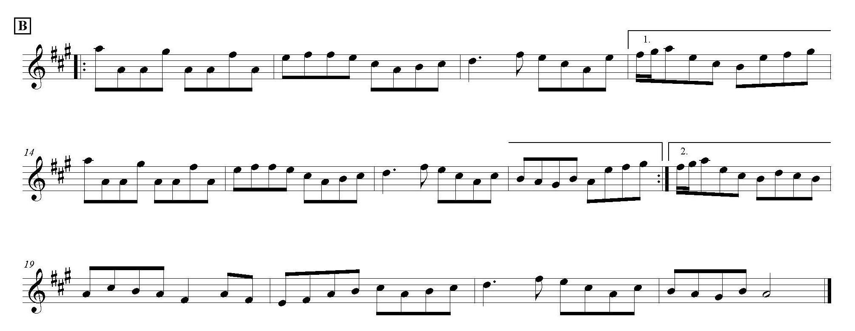
Frank’s Reel

Slide 15
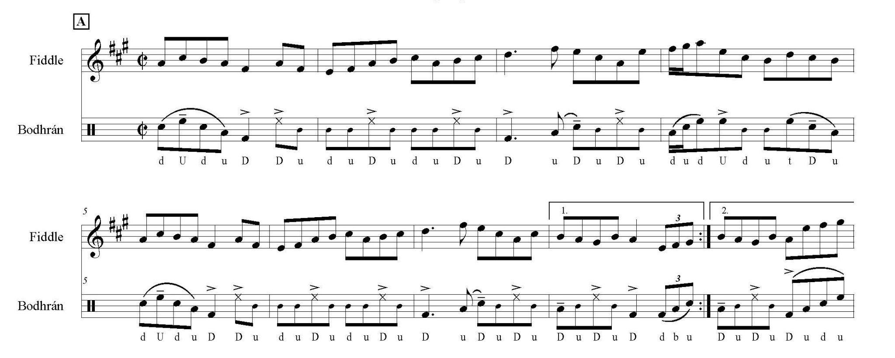
Frank’s Reel

Slide 16
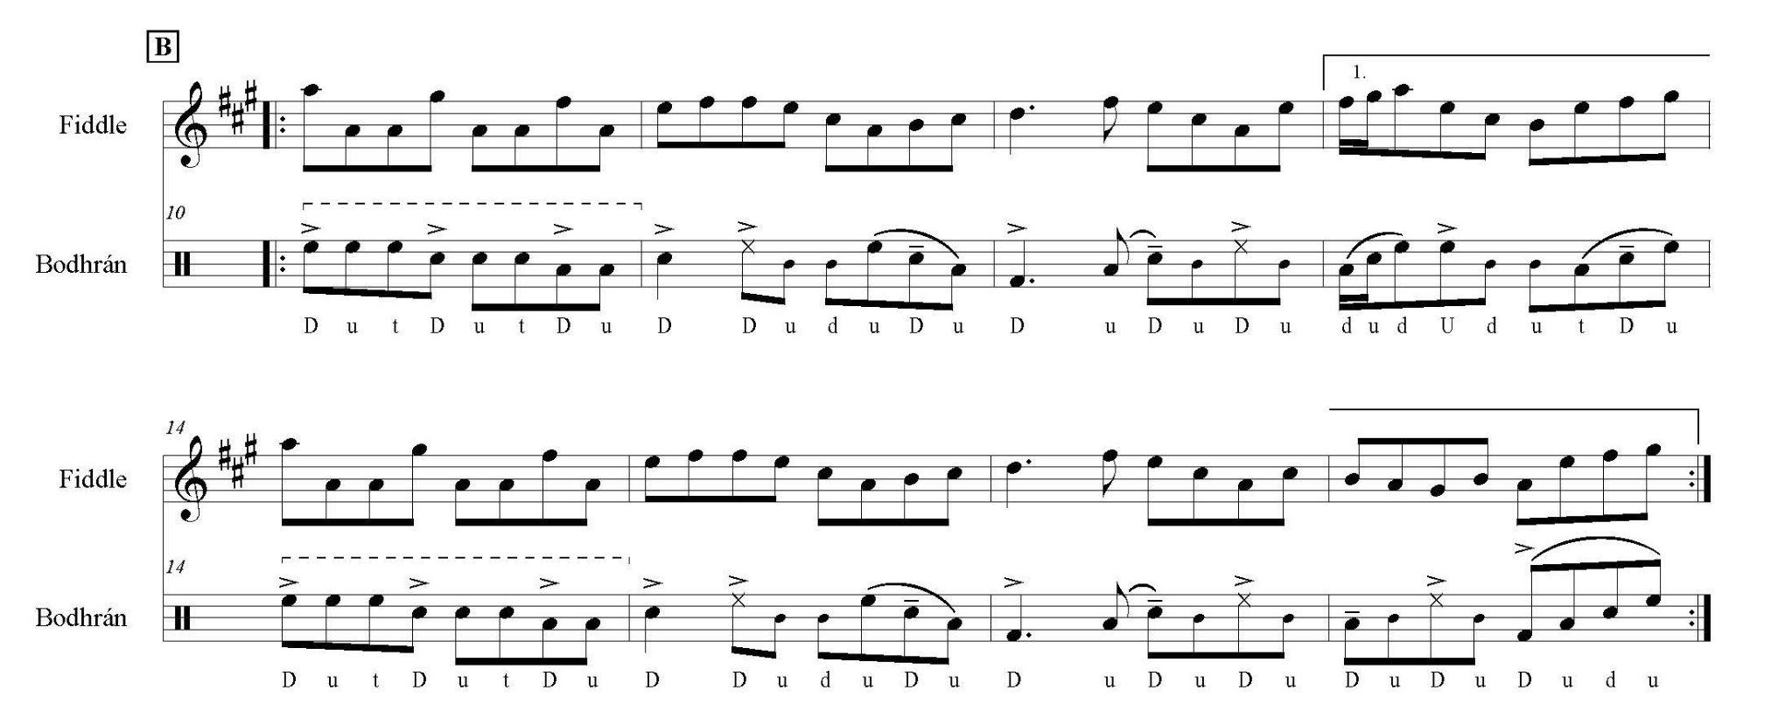
Frank’s Reel

Slide 17
Questions?

Slide 18
Special Thanks
Percussive Arts Society
Andy Kruspe
Clark Cranfill
Courtney Sheffield
Daniel & Laurie Wade
Erin Walker Bliss
Joseph Mannion
Justin Bridgebeck
Rob Forkner
Stevie Moises
Terry W Everson

Slide 19

Contact
Email
jeremywadepercussion@gmail.com
Website
jeremywadepercussion.com
YouTube
Jeremy Wade Bodhrán
Instagram
@jwadepercussion
Workshop Materials

