Slide 1
Music Theory for Irish Dancers
Kentucky Irish Music Academy
Winter 2021

Slide 2

Topics for Discussion
Week One – Intro to Music Theory
Beat, Tempo, Rhythm, and Timing
Rhythmic Notation and Time Signatures
Musical Form
Week Two – Reels
Meter and Tempo
Notation (Soft Shoe/ Hard Shoe)
Anacrusis and Triplets
Week Three – Hornpipes
Meter and Tempo
Notation (Traditional Speed/ Slow Speed)
Swing
Week Four – Jigs
Meter and Tempo
Notation (Light Jigs/ Fast and Slow Treble Jigs)
Hemiola
Week Five – Slip Jigs
Meter and Tempo
Notation (Soft Shoe)
Unusual Phrasing
Week Six – Set Dancing (Video Only/ No Slides)

Slide 3
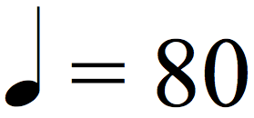

Beat and Tempo
Beat – Quantifiable rhythmic “pulse”
  Downbeat – First/ strongest beat in a measure
    Can also refer to the first beat of a tune
  Clap your hands
Tempo – Frequency of the beat
  Measured in beats per minute (bpm)
  1 second = 60bpm
Tempo vs. Speed
  Speed is a relative designation of how fast/ slow the music feels

Slide 4
Rhythm and Timing
Rhythm – Systematic arrangement of musical sounds/ movements, which are classified by their duration
Timing – Relationship of rhythm to the beat
“On the beat” – Perfect alignment of rhythm with the beat
“Ahead of the beat” – Placement of rhythm just before the beat (i.e. “early”)
“Behind the beat” – Placement of rhythm just after the beat (i.e. “late”)
“Rush” – To execute a rhythm faster than the prescribed tempo
“Drag” – To execute a rhythm slower than the prescribed tempo

Slide 5
Rhythmic Notation
Note Duration: http://www.musictheory.net/lessons/11
Rest Duration: http://www.musictheory.net/lessons/13
Dotted Notes: http://www.musictheory.net/lessons/14

Slide 6
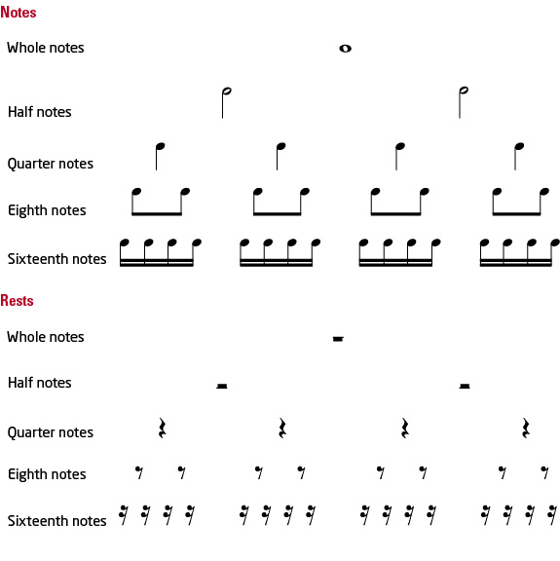
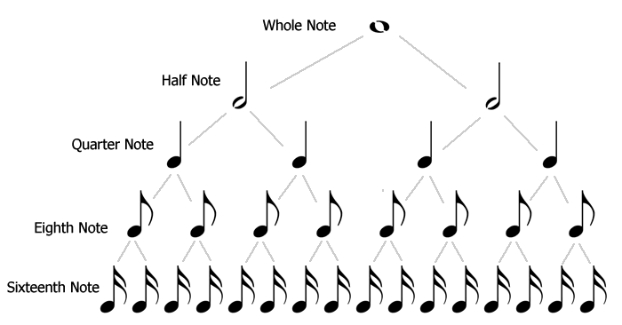
Rhythmic Notation (cont.)

Slide 7
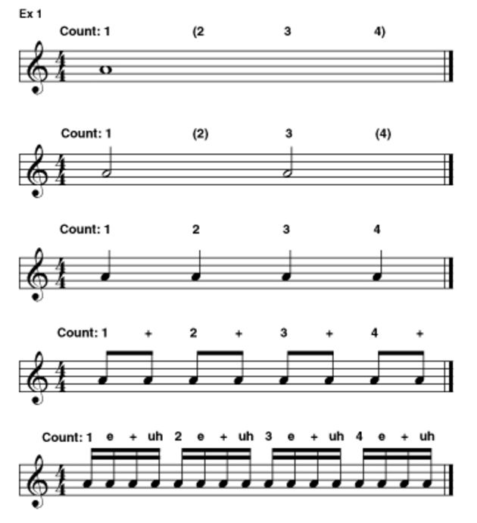
Counting Rhythms
Counting Beats
  Numbers (1, 2, 3, 4…)
Counting Subdivisions
  Syllables (e, +, a)
Phonetic Example
  Quarter Notes: “One/ Two”
  8th Notes: “One, and/ Two, and”
  16th Notes: “One e and uh/ Two e and uh”

Slide 8
Measures and Time Signatures
Measure/ Bar – Used to organize a specific number of beats
http://www.musictheory.net/lessons/12
Time Signature/ Meter – Defines the number of beats in a measure and the duration of each beat
http://www.musictheory.net/lessons/15

Slide 9
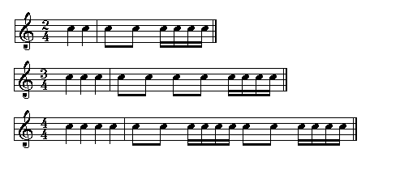
Time Signature (cont.)
Simple – Each beat is divisible by two notes
  Top number represents the number of beats in the measure
  Bottom number represents the note value that receives the beat
  e.g. 2/4 = two beats/ quarter-note receives the beat

Slide 10
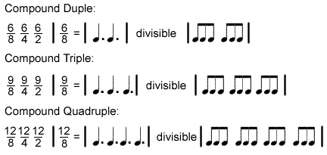

Time Signature (cont.)
Compound – Each beat is divisible by three notes
  Top number represents the number of beat “divisions”
  Bottom number represents the note value of the division
  Divide numerator by 3 to get number of beats (dotted notes)
  e.g. 6/8 = six eighth-notes per measure
    6 divided by 3 = 2
    There are two beats

Slide 11
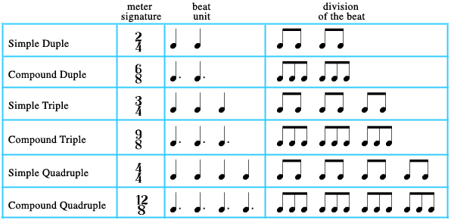
Time Signature (cont.)

Slide 12
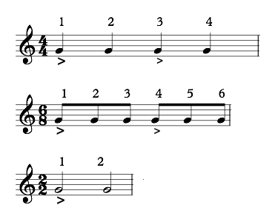
Beat Emphasis
Strong vs. Weak Beats
Strength is dependent upon meter
  e.g. 4/4 – ONE two THREE four
  e.g. 6/8 – ONE two three FOUR five six
Comparison to Syllables
  Simple Meter
    DAY-ton (8th notes)
    CIN-cin-na-ti (16th notes)
  Compound Meter
    LEX-ing-ton/ LOU-is-ville
    col-UM-bus (downbeat occurs on the second syllable)

Slide 13
Musical Form
Phrase
Complete musical thought
AB – “Single” Tune
A section = 8 bar phrase
B section = 8 bar phrase
Example: Red-Haired Lass (Reel)
AABB – “Double” Tune (most common)
A section = 8 bar phrase; repeat A section (Total – 16 bars)
B section = 8 bar phrase; repeat B section (Total – 16 bars)
Example: Tobin’s Favourite (Jig)

Slide 14
Dance & Musical Styles

Slide 15
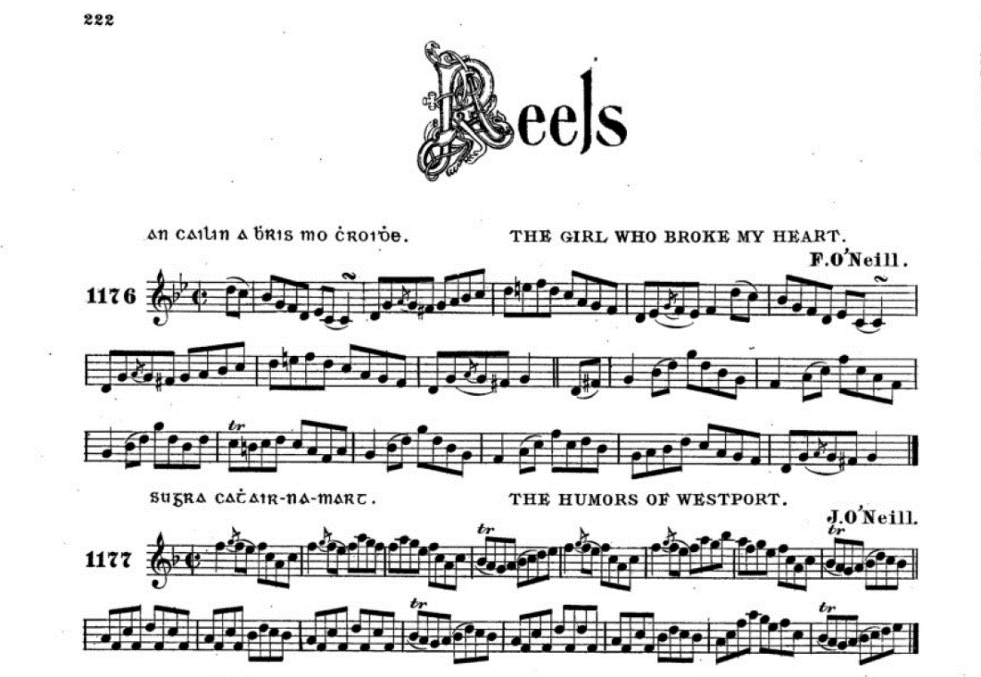
Reels
Origin: Scotland
Meter: Cut Time (2/2) *Common Time (4/4)
Tempo: 92 – 124 bpm
Examples
Sally Gardens
Silver Spear
Joe Cooley’s
O’Neill’s Music of Ireland (Capt. Francis O’Neill – 1903)

Slide 16

Anacrusis/ Pickup
Anacrusis/ Pickup – A note(s) that precedes the downbeat of a tune (or phrase, etc.)
When a tune begins with a pickup, the first complete bar is counted as “measure 1.”
When a dance begins with a pickup note(s) – like many hard shoe steps – keep in mind that the musicians would likely count the first bar of “dance” as “measure 9” since they have already played eight bars.

Slide 17
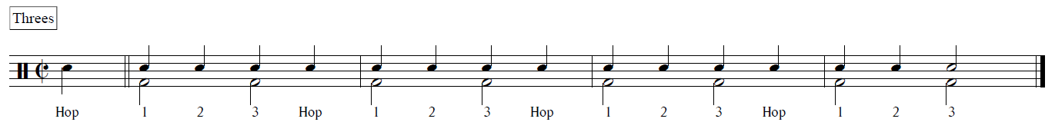
Reels – Soft Shoe
Threes
Steps – “Hop, 1, 2, 3, Hop, 1, 2, 3”
Counts – “and/ 1 and 2 and/ 1 and 2”
*Notes on the bottom (F) space represent the beat

Slide 18
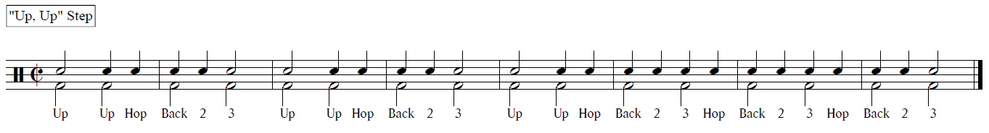
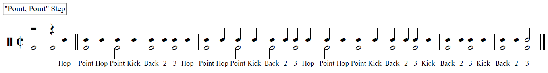
Reels – Soft Shoe (cont.)

Slide 19
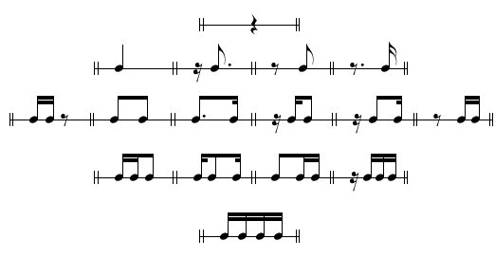
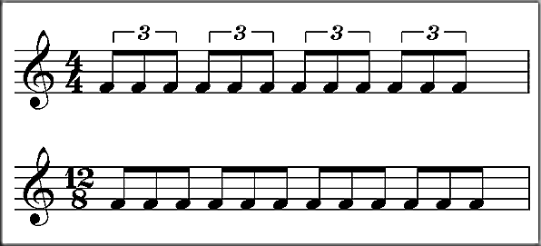

Triplets
Triplet – Division of a beat (or any note value) into three notes of equal duration
Combinations of three notes do not necessarily equate to triplets…
These groupings include both 16th notes and 8th notes (which are twice as long)

Slide 20
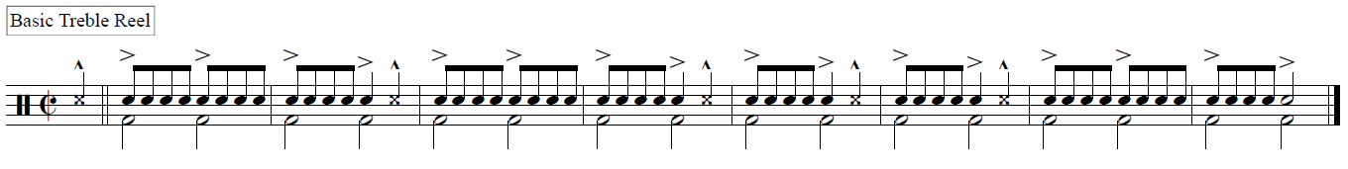
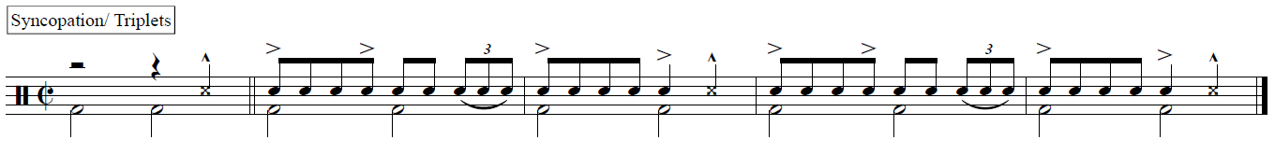
Reels – Hard Shoe
Basic Treble Reel
Steps – “Stamp, Down Shuffle Hop Back” etc.
Counts – “+/ 1e+a 2e+a/ 1e+a 2 +” etc.

Slide 21
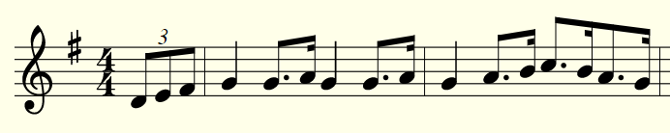
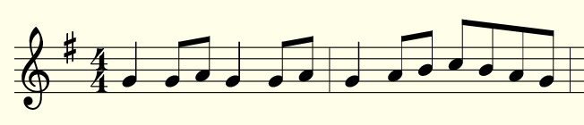
Hornpipes
Origin: England
Meter: 4/4
Emphasis – Beats ‘2’ and ‘4’
Tempo: (76) 113 – 144 bpm
Examples
Boys of Bluehill
Cork Hornpipe
Downfall of Paris
Downfall of Paris – Dotted 8th/ 16th-Notes
Downfall of Paris – Swung 8th-Notes

Slide 22
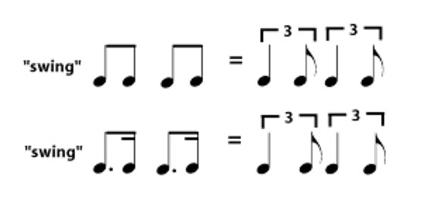
Swing
Swing – Augmentation of the first note in a pair of notes
Straight 8th-notes/ 16th-notes:
Evenly divided “duple” rhythms
Swung 8th-notes/ 16th-notes:
Resemble “triple” rhythms

Slide 23
Swing (cont.)
Degree of Swing
  Straight 8th-Notes
  Triplets
  Dotted 8th/ 16th-Notes
May be interpreted differently from one musician to another
May differ between geographic regions
May change with tempo (e.g. faster tempo = straight 8th feel)

Slide 24
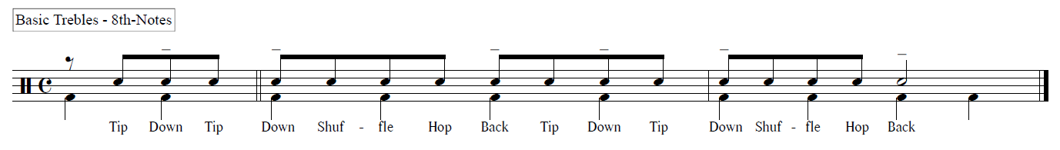
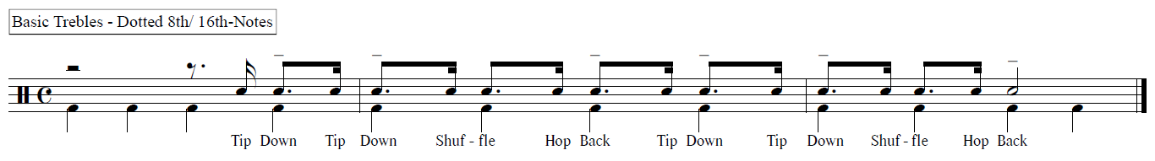
Hornpipes – Traditional Speed
Basic Trebles
Steps – “Tip Down, Tip Down, Shuffle, Hop Back” etc.
Counts – “a 4-a/ 1-a 2-a 3-” etc.

Slide 25
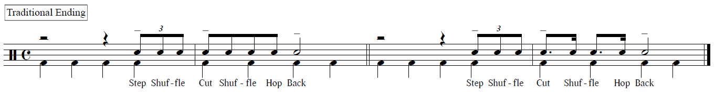
Hornpipes – Traditional Speed (cont.)
Traditional Ending
Steps – “Step Shuffle Cut, Shuffle, Hop Back”
Counts – “4+a/ 1-a 2-a 3”
*Hornpipe phrases typically end on Beat ‘3’

Slide 26
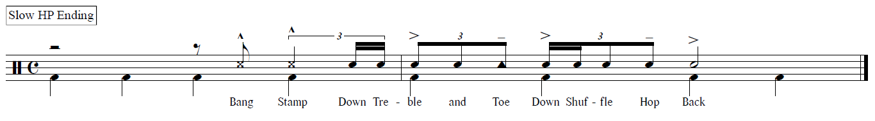
Hornpipes – Slow Speed
Common Slow Hornpipe Ending
Steps – “Down Treble and Toe, Down Shuffle Hop Back”
*8th-Notes are still “swung”
*Triplet subdivision is more prominent

Slide 27
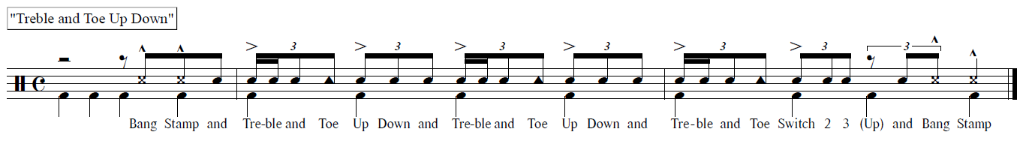
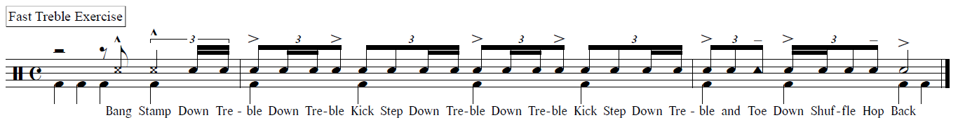
Hornpipes – Slow Speed (cont.)

Slide 28
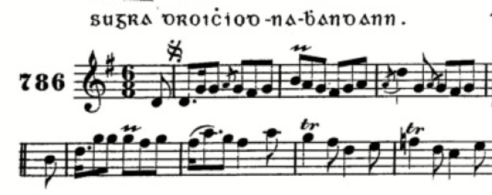
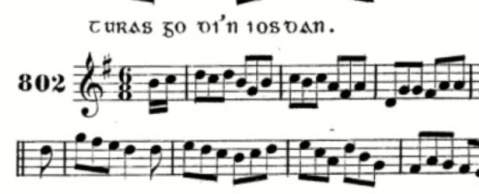
Jigs
Origin: England
Meter: 6/8
Tempo: (66) 92 – 124 bpm
Examples
Tobin’s Favourite
Geese in the Bog
The Vanishing Lake
The Humours of Bandon – James O’Neill
A Trip to the Cottage – James O’Neill

Slide 29
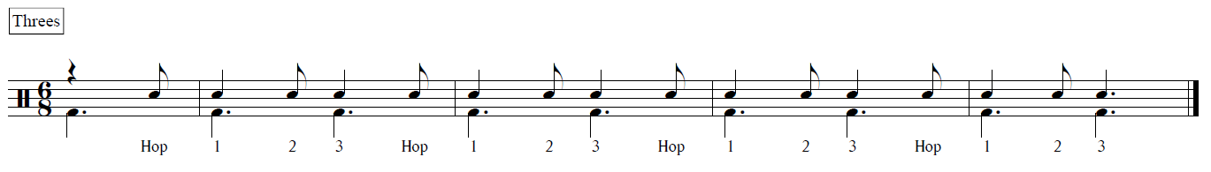
Jigs – Light Jig
Threes
Steps – “Hop 1, 2 3, Hop 1, 2 3” etc.
Counts – “6/ 1-3 4-6/ 1-3 4” etc.
Compare to Reels: Short/ Long vs. Evenly-Spaced

Slide 30
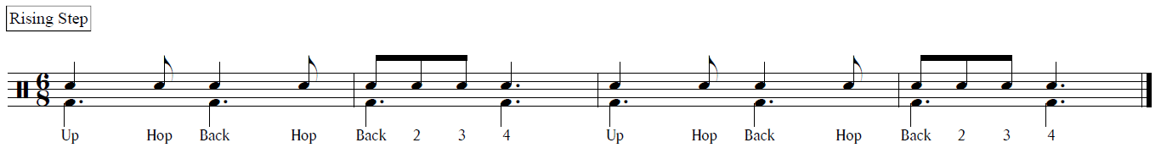
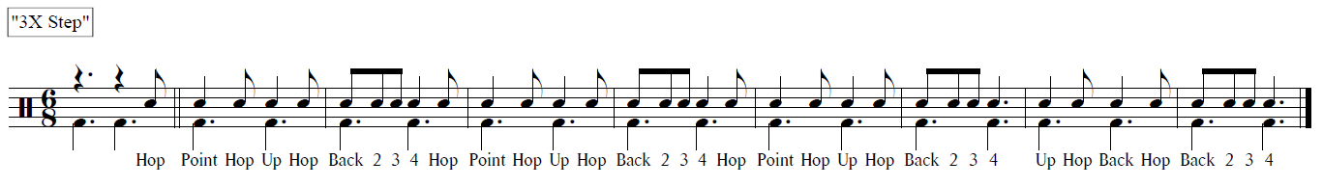
Jigs – Light Jig (cont.)
Rising Step
Steps – “Up, Hop Back, Hop Back 2 3 4”
Counts – “1-3 4-6/ 1 2 3 4—”

Slide 31
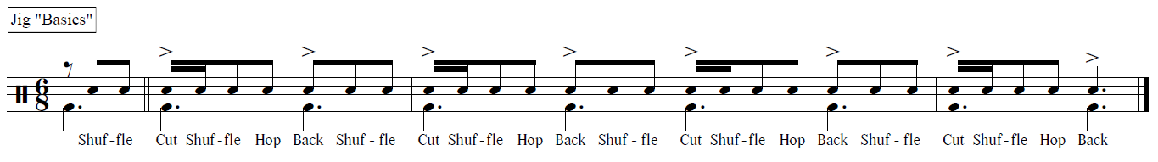
Jigs – Fast Treble Jig
Treble Jig “Basics”
Steps – “Shuffle, Cut Shuffle, Hop, Back”
Counts – “5 6/ 1+2 3 4”

Slide 32
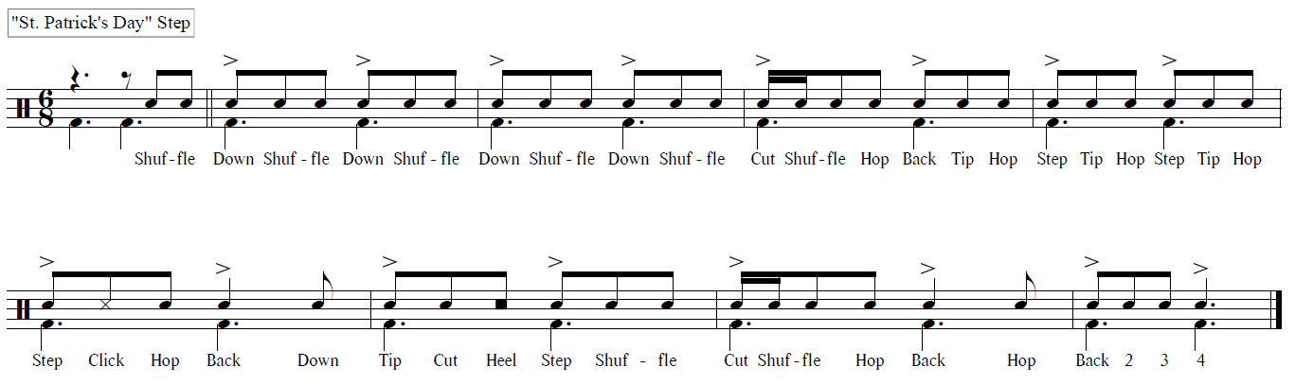
Jigs – Fast Treble Jig (cont.)

Slide 33
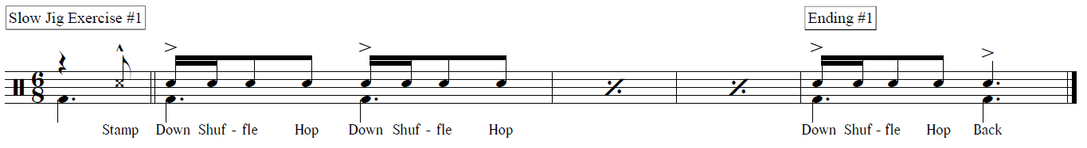
Jigs – Slow Treble Jig
Slow Treble Jig Exercise #1
Steps – “Stamp/ Down Shuffle, Hop, Down Shuffle, Hop”
Counts – “6/ 1+2 3 4+5 6”

Slide 34
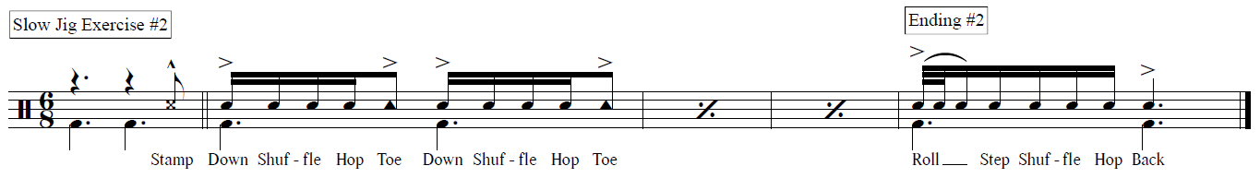
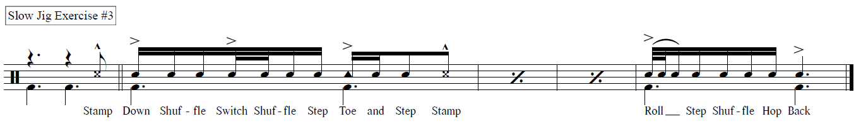
Jigs – Slow Treble Jig (cont.)
“Ending #2” could be counted: “1e+ 2 + 3 + 4”

Slide 35
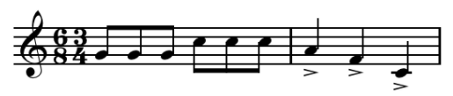
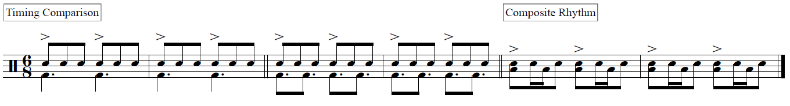
Hemiola
Hemiola – A musical figure in which, typically, two groups of three beats are replaced by three groups of two beats, giving the effect of a shift from duple to triple meter.
Example – 6/8 superimposed over 3/4
Both have six 8th-Notes
6/8 has two groupings of three 8th-Notes
3/4 has three groupings of two 8th-Notes
“America” – from West Side Story (Sondheim/ Bernstein) employs “mixed-meter” phrasing, alternating between 6/8 and 3/4.

Slide 36
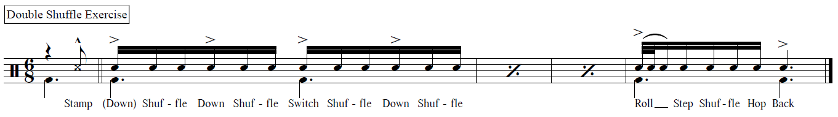
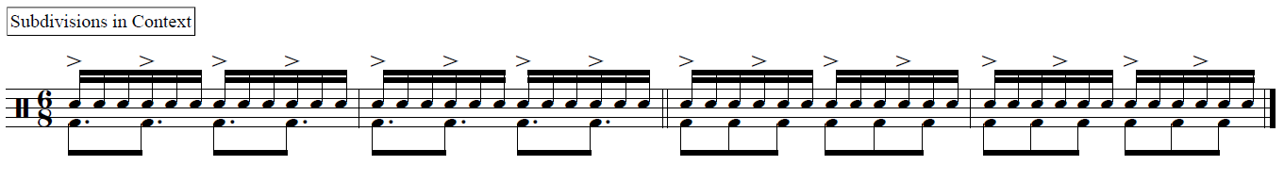
Jigs – Slow Treble Jig (cont.)
The accent pattern creates the illusion of a shift to a simple meter (i.e. 4/4)

Slide 37
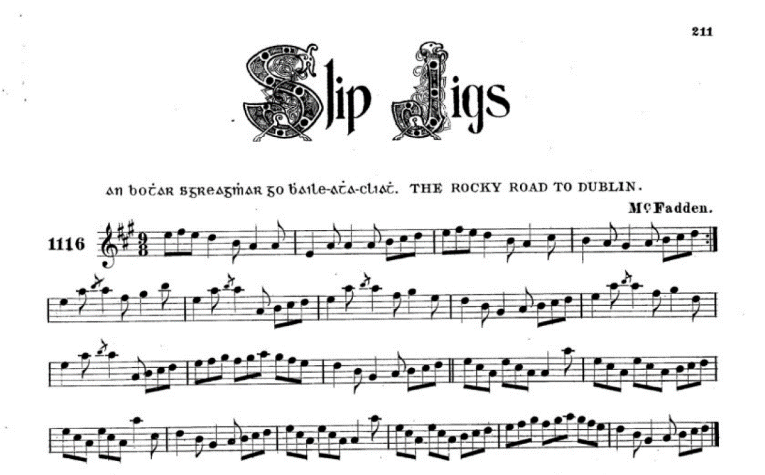
Slip Jigs
Origin: Ireland
Meter: 9/8
Tempo: 113 – 122 bpm
Examples
The Kid on the Mountain
The Butterfly
The Drops of Brandy
O’Neill’s Music of Ireland (Capt. Francis O’Neill – 1903)

Slide 38
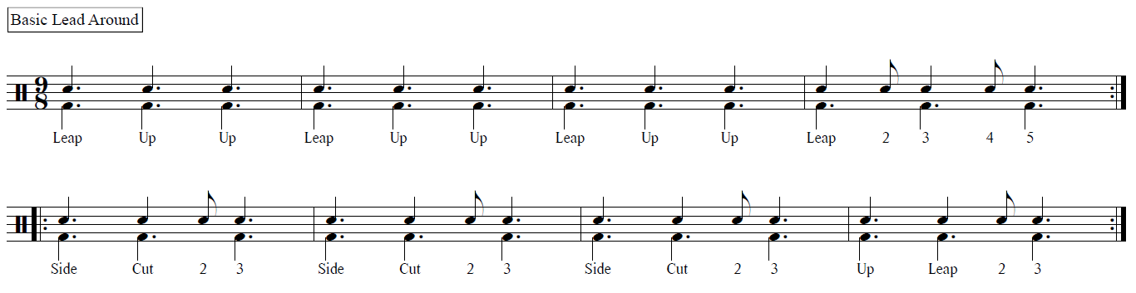
Slip Jigs (cont.)
Basic Lead Around
Steps – “Leap, Up, Up” etc.
Counts – “1, 2, 3” etc.
*Leaps “land” on the beat

Slide 39
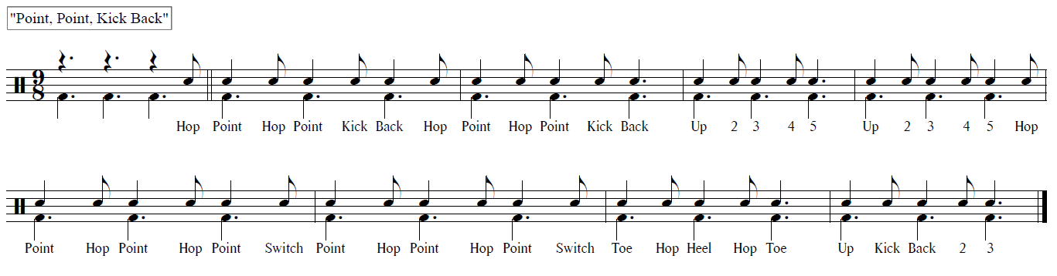
Slip Jigs (cont.)
Point, Point, Kick Back
Steps – “Hop Point, Hop Point, Kick Back” etc.
Counts – “9/ 1-3 4-6 7--” etc.

Slide 40
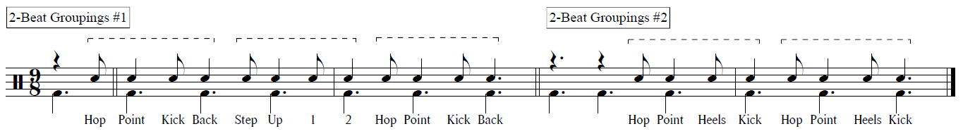
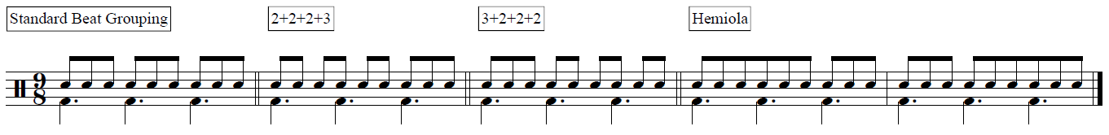
Slip Jigs – Unusual Phrasing
Occasionally, slip jig rhythmic “motives” will occupy a 2-beat space within the context of a 6-beat phrase. This can often lead to steps [musically] extending across the barline, creating the illusion of a shift in meter.
Musically, 8th-Notes may be grouped asymmetrically to alter the perceived beat duration.
*The 2+2+2+3 pattern is reminiscent of Blue Rondo à la Turk (Dave Brubeck)

Slide 41
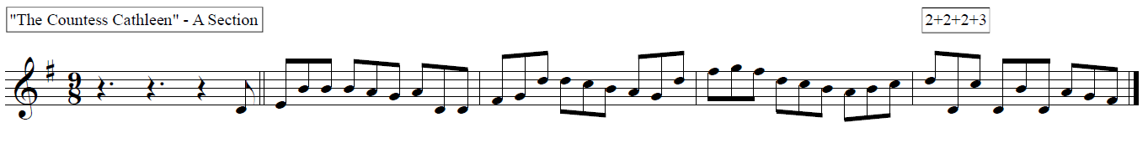
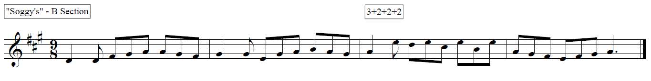
Slip Jigs – Unusual Phrasing (cont.)
Melody is often used to shift the emphasis of the beat by “pairing” alternating pitches.
See Bar 4 of The Countess Cathleen (A Section) for an example of 2+2+2+3
See Bar 3 of Soggy’s (B Section) for an example of 3+2+2+2

